Slide 1
Notation and Examples

Slide 2
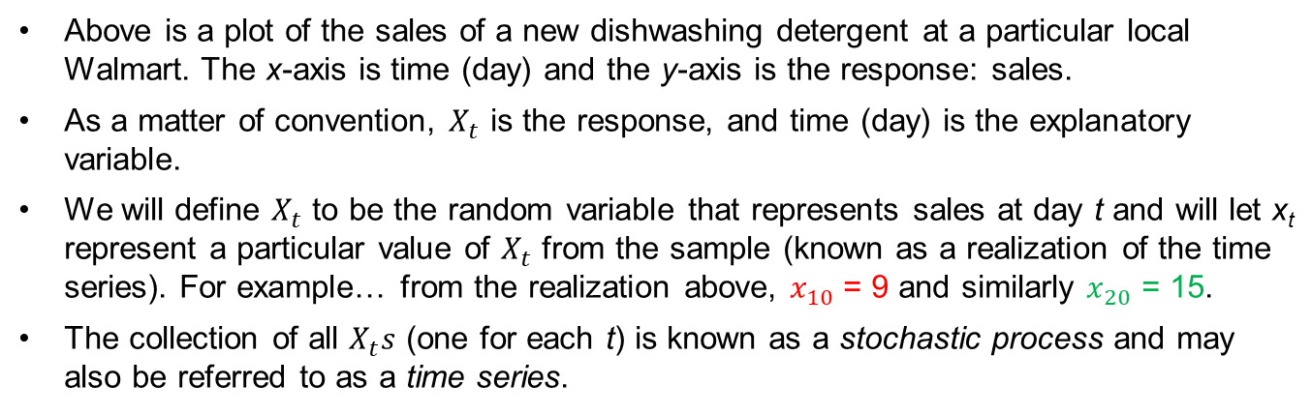
Notation
Sales
Day
Above is a plot of the sales of a new dishwashing detergent at a particular local Walmart. The x-axis is time (day) and the y-axis is the response: sales.
As a matter of convention, $X_{t}$ is the response, and time (day) is the explanatory variable.
We will define $X_{t}$ to be the random variable that represents sales at day t and will let x_{t} represent a particular value of $X_{t}$ from the sample (known as a realization of the time series). For example… from the realization above, $x_{10}$ = 9 and similarly $x_{20}$ = 15.
The collection of all $X_{t}s$ (one for each t) is known as a stochastic process and may also be referred to as a time series.
Notes:
Animate line by line. … Try and get the numbers bigger and change labels.

Slide 3
Examples of Time Series

Slide 4
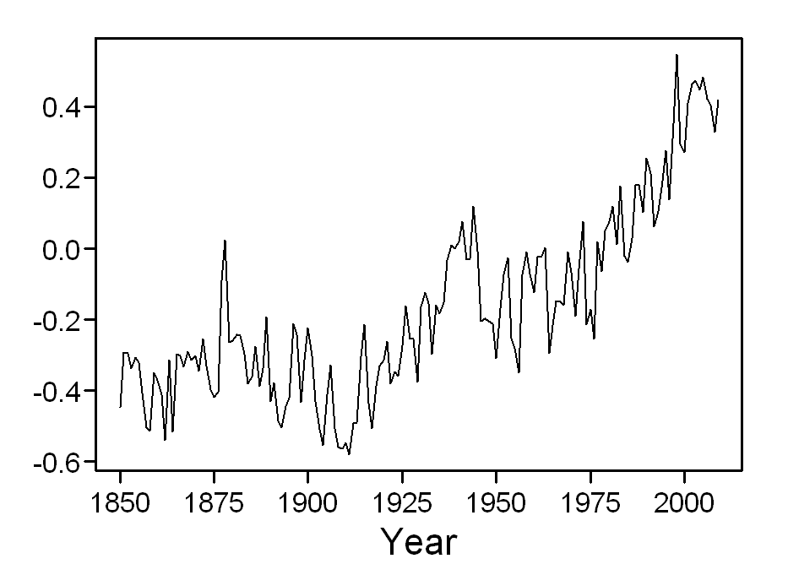
Global Temperatures
Change from global mean

Slide 5
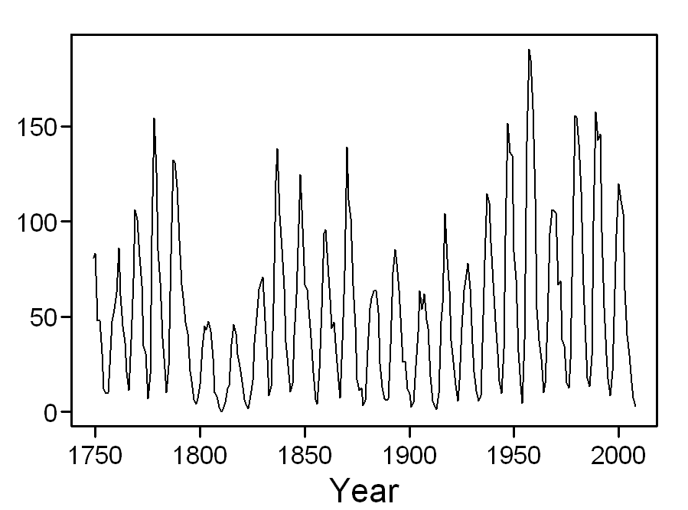
Annual Sunspot Numbers
Number of sunspots
Notes:
TIME / YEAR

Slide 6
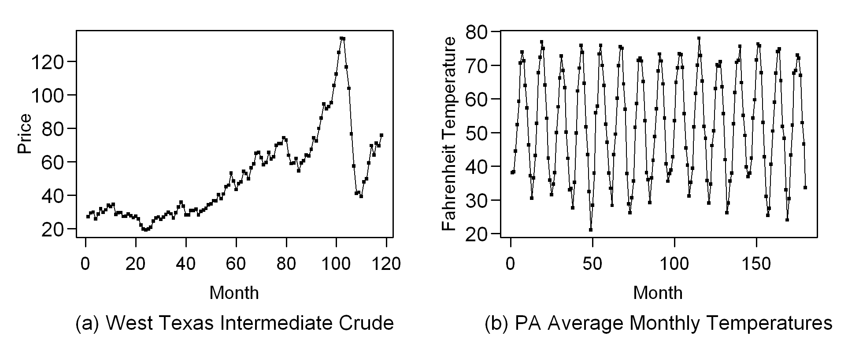
Monthly Price of West Texas Intermediate Crude Oil

Slide 7
Average Monthly Temperature in Pennsylvania

Slide 8
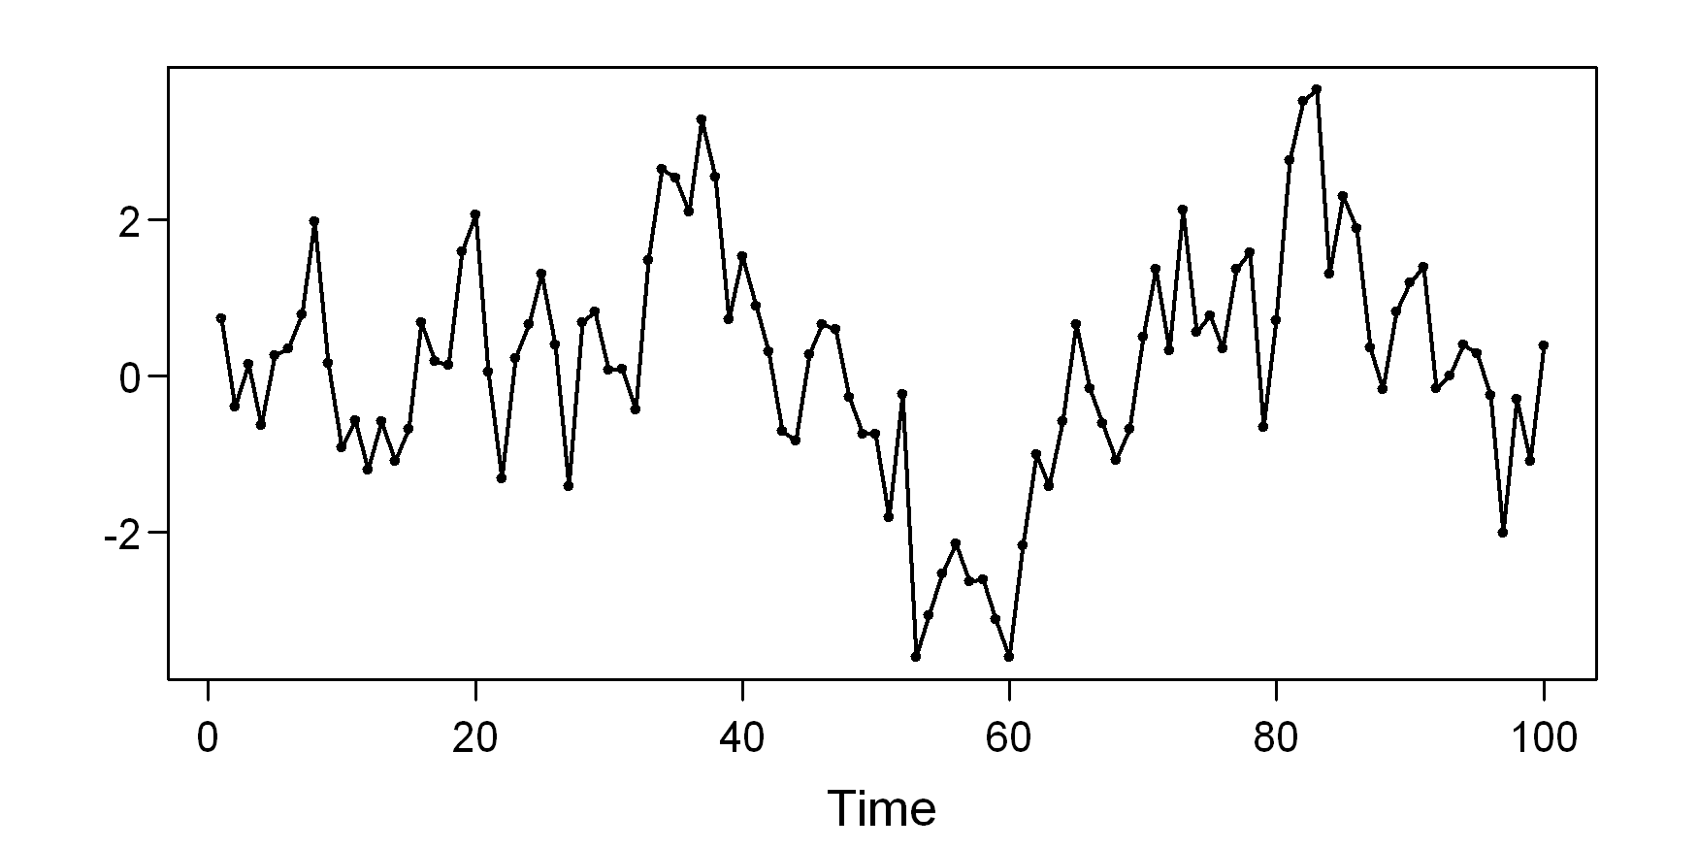
Simulated Data

Slide 9
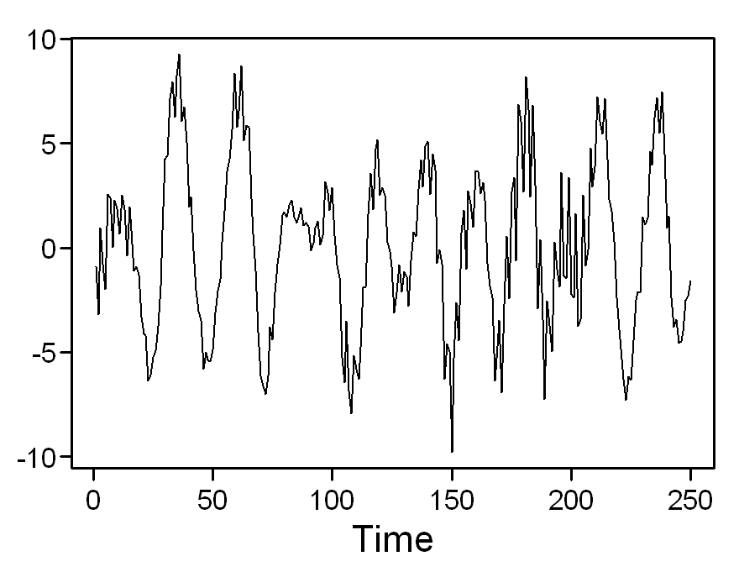
Simulated Data

Slide 10
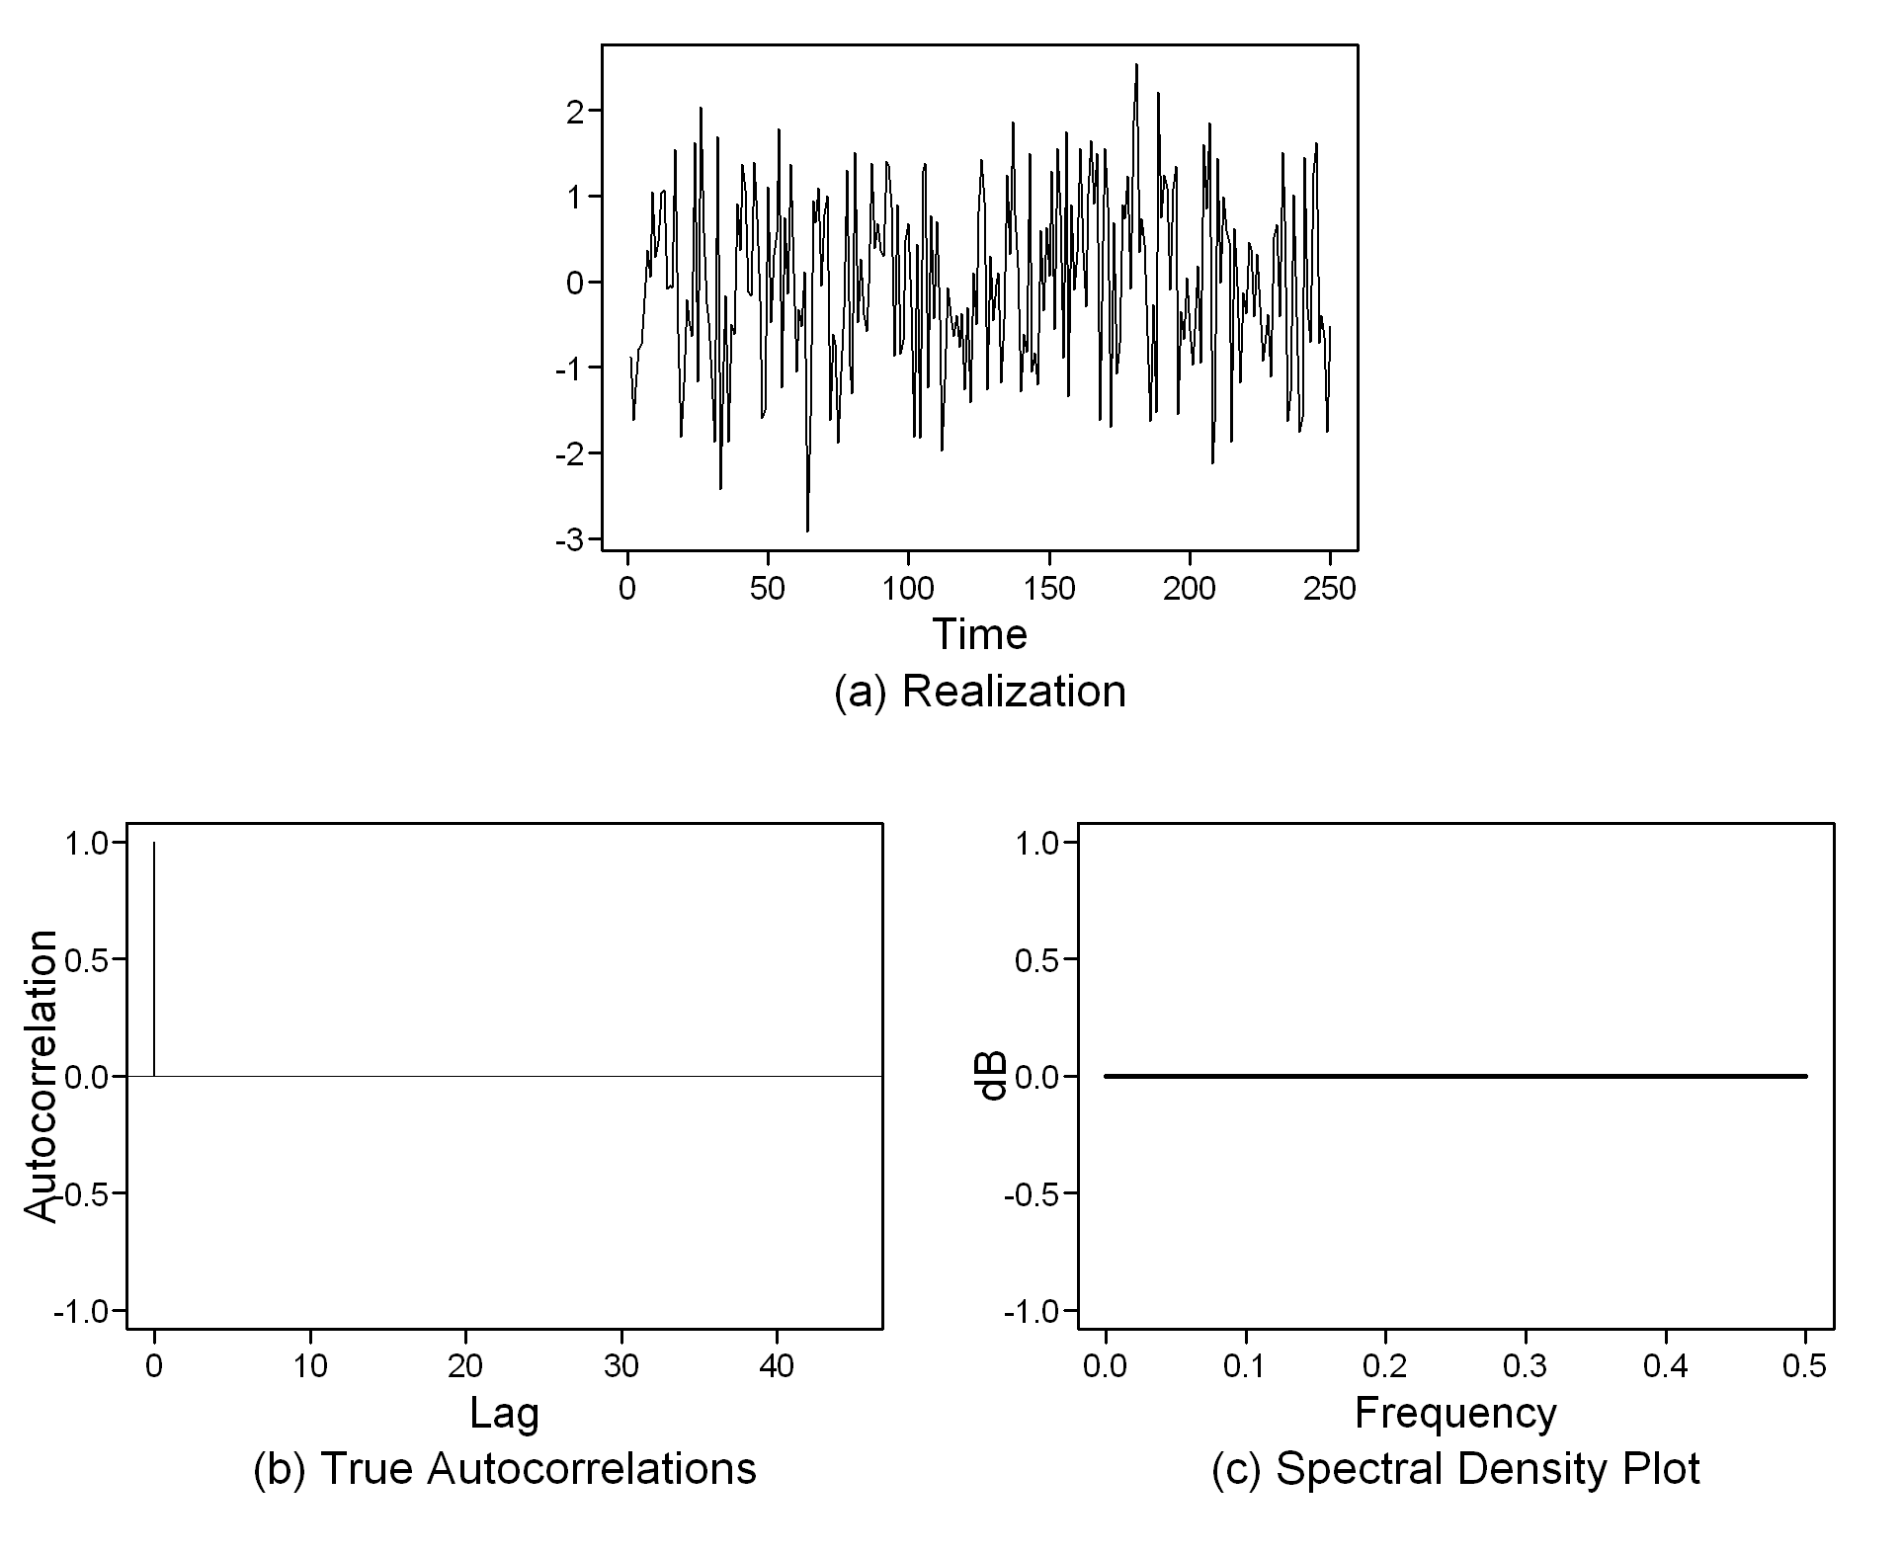
Simulated Data

Slide 11
Google Stock Price

Slide 12
Doppler Signal
dB
Time

Slide 13
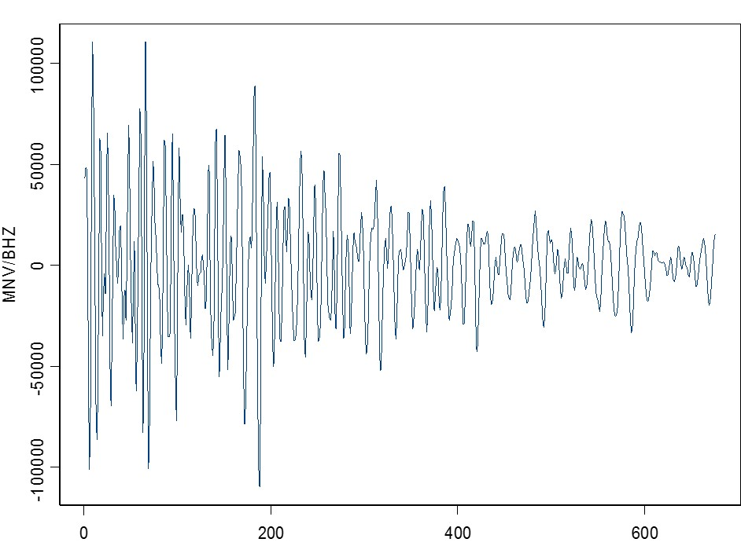
Seismic Wave of a Mining Explosion

Slide 14
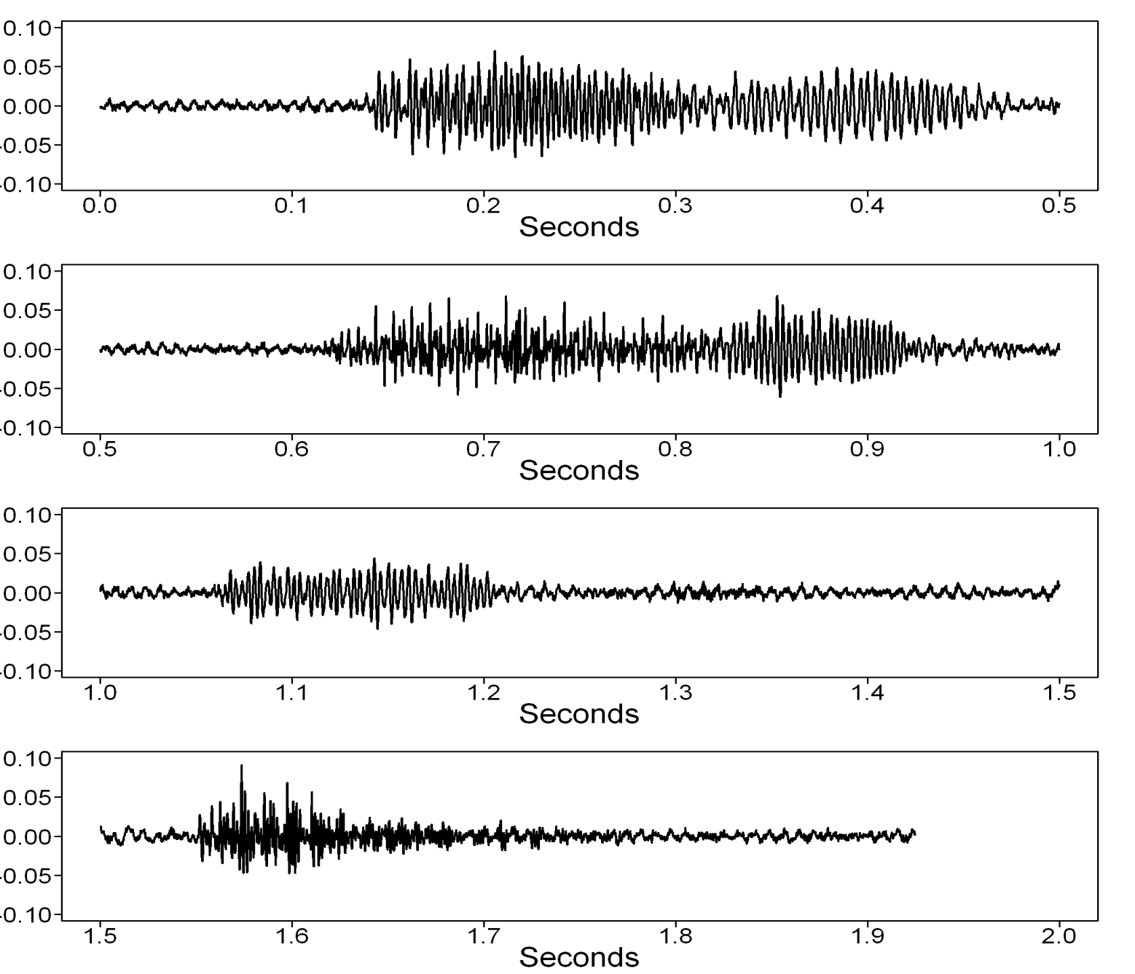
Acoustical Signal of the Phrase “King Kong Eats Grass”
(Fan noise in background)
dB
dB
dB
dB

Slide 16
Realization vs. Ensemble/Motivation

Slide 17
Realization
A realization is a particular instance of time series.
You can think of a realization as one of the infinitely many possible time series that we could have observed.
The realization is the one we actually observed.
Consider four more Walmarts that each sold dish soap on the same days.
Recall the opening example about the sales of Walmart dish soap at a particular store. Usually we will only have data from one realization although in some settings we may have data from several. In addition to the single Walmart sales time series realization (above right), if we considered 4 more Walmarts that each sold dish soap on the same days, we would have 5 different realizations. We could plot all 5 realizations on the same plot (lower right). The one from above is store 1 and is represented in red.
Notes:
Too many words… make a bulleted list and describe the above in words.

Slide 18
Realization
A realization is a particular instance of time series.
You can think of a realization as one of the infinitely many possible time series that we could have observed.
The realization is the one we actually observed.
Consider four more Walmarts that each sold dish soap on the same days.
Sometimes it is impossible to obtain more than one realization. Take for instance West Texas crude oil prices.
Recall the opening example about the sales of Walmart dish soap at a particular store. Usually we will only have data from one realization although in some settings we may have data from several. In addition to the single Walmart sales time series realization (above right), if we considered 4 more Walmarts that each sold dish soap on the same days, we would have 5 different realizations. We could plot all 5 realizations on the same plot (lower right). The one from above is store 1 and is represented in red.
Notes:
Too many words… make a bulleted list and describe the above in words.

Slide 19
Realization
A realization is a particular instance of time series.
You can think of a realization as one of the infinitely many possible time series that we could have observed.
The realization is the one we actually observed.
Consider four more Walmarts that each sold dish soap on the same days.
Sometimes it is impossible to obtain more than one realization. Take for instance West Texas crude oil prices.
The ensemble is the totality of all possible realizations. (It is often impractical or impossible to view.) Ensemble equals population.
Recall the opening example about the sales of Walmart dish soap at a particular store. Usually we will only have data from one realization although in some settings we may have data from several. In addition to the single Walmart sales time series realization (above right), if we considered 4 more Walmarts that each sold dish soap on the same days, we would have 5 different realizations. We could plot all 5 realizations on the same plot (lower right). The one from above is store 1 and is represented in red.
Notes:
Too many words… make a bulleted list and describe the above in words.

Slide 20
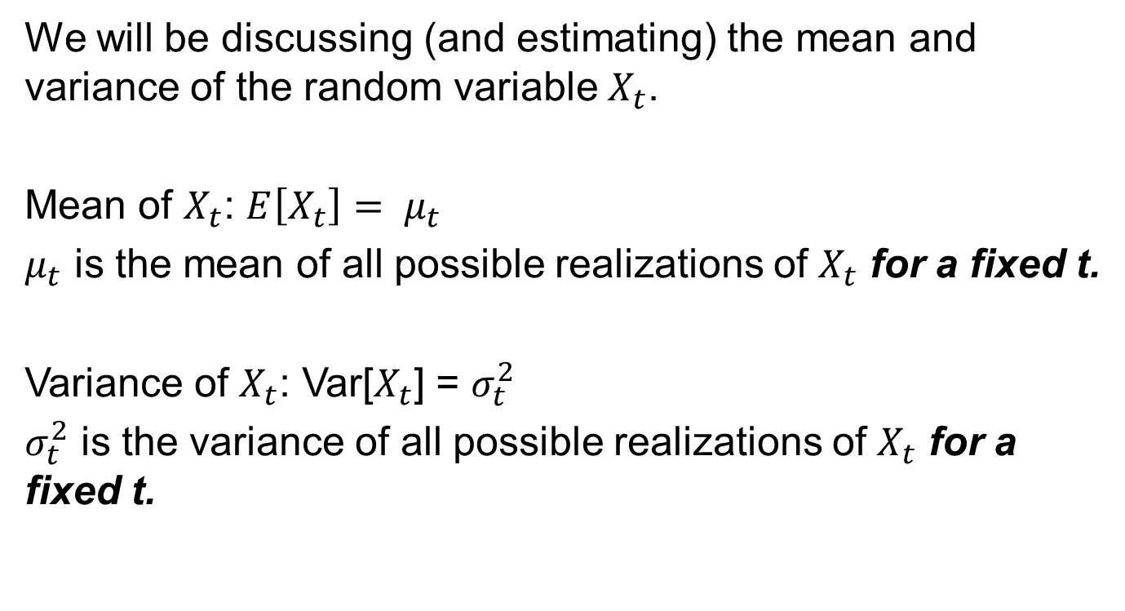
The Mean and Variance of X_{t}
We will be discussing (and estimating) the mean and variance of the random variable $X_{t}$.
Mean of $X_{t}$: $E\left[X_{t}\right]= μ_{t}$
$μ_{t}$ is the mean of all possible realizations of $X_{t}$ for a fixed t.
Variance of $X_{t}$: Var[$X_{t}$] = $σ_{t}^{2}$
$σ_{t}^{2}$ is the variance of all possible realizations of $X_{t}$ for a fixed t.

Slide 21

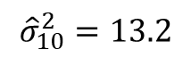
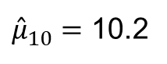
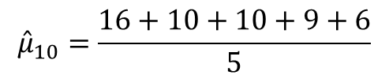
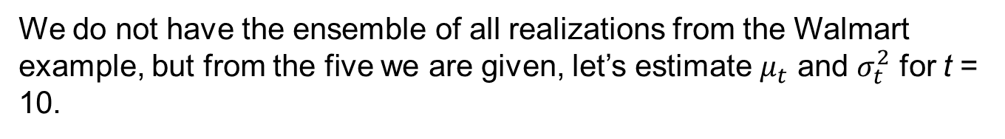
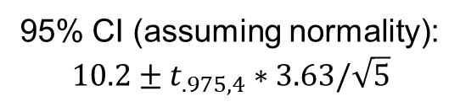
Example
We do not have the ensemble of all realizations from the Walmart example, but from the five we are given, let’s estimate $μ_{t}$ and $σ_{t}^{2}$ for t = 10.
$${\hat{μ}}_{10}=\frac{16+10+10+9+6}{5}$$
${\hat{μ}}_{10}=$ 10.2
Student t (not time)
$${\hat{σ}}_{10}^{2}=13.2$$
95% CI (assuming normality):
$$10.2±t_{.975,4}∗3.63/\sqrt{5}$$
The means and variances could have been estimated in this fashion for all of the 50 possible values of t in this time series.
Day
Notes:
Change Time to “Day” on horizontal axis.

Slide 22

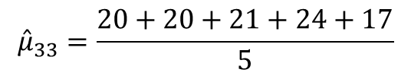
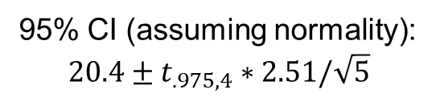
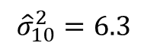
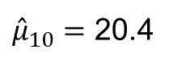
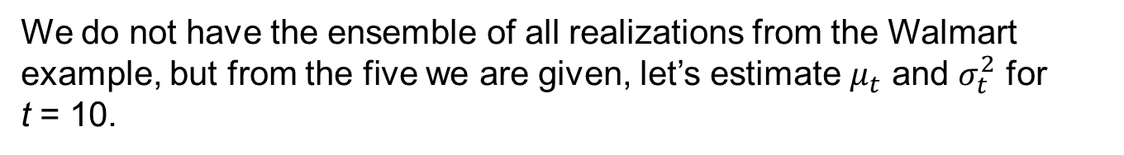
Example
We do not have the ensemble of all realizations from the Walmart example, but from the five we are given, let’s estimate $μ_{t}$ and $σ_{t}^{2}$ for t = 10.
$${\hat{μ}}_{33}=\frac{20+20+21+24+17}{5}$$
${\hat{μ}}_{10}=$ 20.4
$${\hat{σ}}_{10}^{2}=6.3$$
95% CI (assuming normality):
$$20.4±t_{.975,4}∗2.51/\sqrt{5}$$
The means and variances could have been estimated in this fashion for each of the 50 possible values of t in this time series.

Slide 23
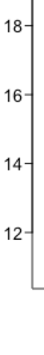
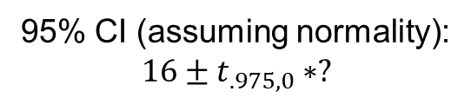
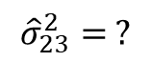
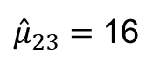
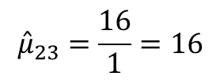
Example
In the time series setting, we typically only get one realization. Like the West Texas Intermediate crude data. We can’t turn back time and see it all over again. There is only one reality/realization. Can we still estimate the mean and variance and construct a 95% confidence interval?
$${\hat{μ}}_{23}=\frac{16}{1}=16$$
${\hat{μ}}_{23}=$ 16
$${\hat{σ}}_{23}^{2}= ?$$
95% CI (assuming normality):
$$16±t_{.975,0}∗?$$
For each time point (t) there is only one observation, and thus, while we can theoretically get a trivial estimate of the mean, we cannot estimate the variance with only one point. What can we do?
Notes:
Find a better realization that goes back and forth across the mean more times.

Slide 25
Expected Value

Slide 26
Expected Value
In short, the expected value of a random variable X (E[X]) is the mean or intuitively the long-run average of the event that variable represents.
For example:
Consider a variable X that represents the amount of money won in a particular casino game. X represents the amount won or lost (negative amount) and P(X) represents the probability of that event. We could organize this idea in a table:
X | P(X)
2 | .1
0 | .3
–1 | .6
This indicates that there is a 10% chance that the player will win $2, a 30% chance that they will break even (win $0 but lose $0), and a 60% chance that they will lose $1.
Should casino goers play this game? If they played this game many times, what would be their average winnings or losings?
These questions can be addressed by looking at the expected win or loss (the expected value) each time they play.
$Expected value of X=E\left[X\right]=\$2 ∗ .1+\$0∗.3+\left(−\$1\right)∗.6 =$–$0.4
In this game, each time the player plays this game, he or she is expected to lose, on average, $0.4, or 40 cents.
Spoiler alert, all games in Las Vegas have a negative expected value!

Slide 27
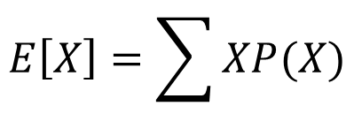
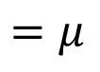
Expected Value
Recall, since X cannot take on any value between the ones listed above, we know that X is a discrete random variable.
X | P(X)
2 | .1
0 | .3
–1 | .6
P(X) shows how the probabilities are distributed to the potential values of X. P(X) is known as a discrete probability distribution function (pdf).
$Expected value of X=E\left[X\right]=\$2 ∗ .1+\$0∗.3+\left(−\$1\right)∗.6 =$–$0.4
$$E\left[X\right]=\sum{XP(X)}$$
$$=μ$$
Formula for the expected value of a discrete random variable X
The expected value of X (E[X] is the population mean of the distribution)

Slide 28
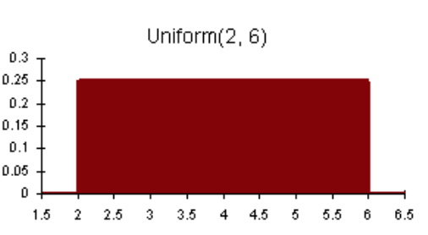
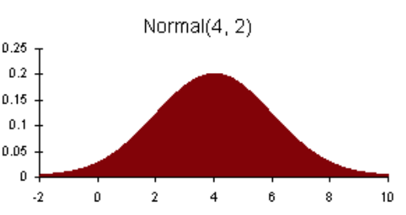
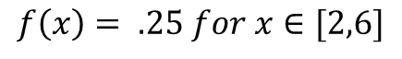
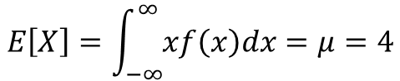
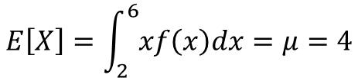
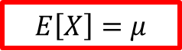
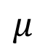
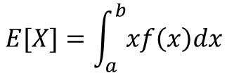
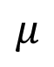
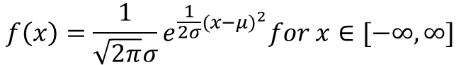
Expected Value
What about a continuous random variable X?
Continuous random variables also have probability distributions/density functions (f(x)).
$$f\left(x\right)=\frac{1}{\sqrt{2π}σ}e^{\frac{1}{2σ}{(x−μ)}^{2}}for x∈[−∞,∞]$$
$$f\left(x\right)= .25 for x∈[2,6]$$
$$E[X]=\int_{a}^{b}{xf\left(x\right)dx}$$
$$μ$$
$$μ$$
$$E\left[X\right]=\int_{2}^{6}{xf\left(x\right)dx}=μ=4$$
Main takeaway
$$E\left[X\right]=\int_{−∞}^{∞}{xf\left(x\right)dx}=μ=4$$
$$E\left[X\right]=μ$$

Slide 29
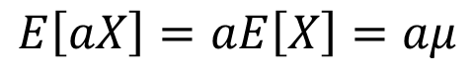
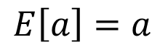
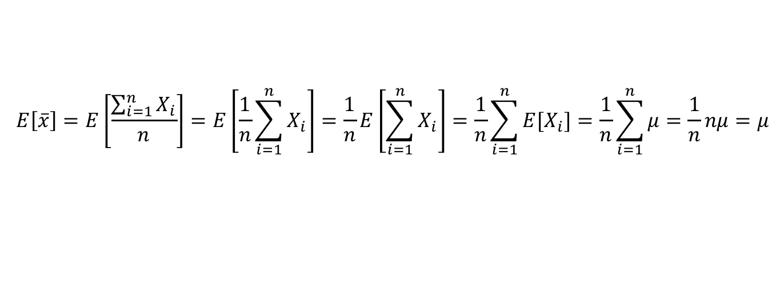
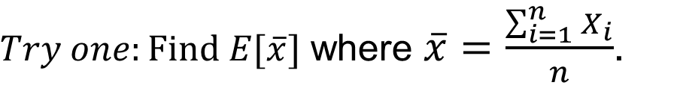
Expected Value
Properties
Let a and b be constants.
$$E\left[a\right]=a$$
$$E\left[aX\right]=aE\left[X\right]=aμ$$
$E\left[aX+b\right]=aE\left[X\right]+E\left[b\right]=aE\left[X\right]+b$ $=aμ$+b
$Try one:Find E[\overline{x}]$ where $\overline{x}=\frac{\sum_{i=1}^{n}{X_{i}}}{n}$.
$$E\left[\overline{x}\right]=E\left[\frac{\sum_{i=1}^{n}{X_{i}}}{n}\right]=E\left[\frac{1}{n}\sum_{i=1}^{n}{X_{i}}\right]=\frac{1}{n}E\left[\sum_{i=1}^{n}{X_{i}}\right]=\frac{1}{n}\sum_{i=1}^{n}{{E[X}_{i}]}=\frac{1}{n}\sum_{i=1}^{n}{μ}=\frac{1}{n}nμ=μ$$

Slide 31
Variance

Slide 32
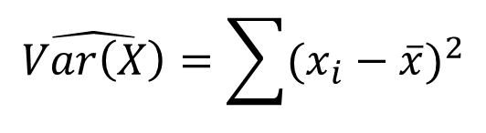
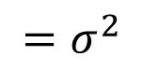
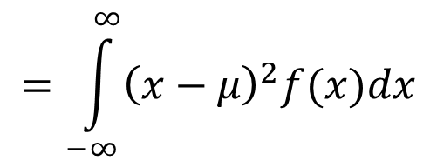
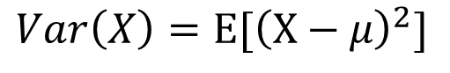
Variance
$$Var\left(X\right)=E[{\left(X−μ\right)}^{2}]$$
$$=\int_{−∞}^{∞}{{\left(x−μ\right)}^{2}f(x)dx}$$
Main takeaways
$$=σ^{2}$$
$$\hat{Var\left(X\right)}=\sum{{(x_{i}−\overline{x})}^{2}}$$

Slide 34
Covariance

Slide 35
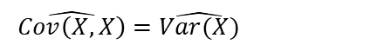
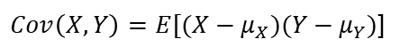
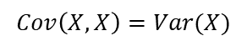
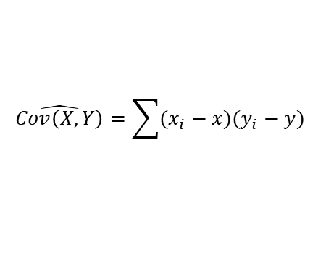
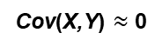
Covariance
Next, consider two random continuous variables X and Y.
We would like a measure of how much they move together.
That is, as X gets bigger, does Y tend to get smaller, larger, or is Y independent of X?
This can be measured with the covariance of X and Y: Cov(X,Y).
Estimate of the covariance of X and Y from the data
Known as the
“sum of the cross products”
$Cov\left(X,Y\right)=E[(X−μ_{X})(Y−μ_{Y})$]
$$\hat{Cov\left(X,Y\right)}=\sum{(x_{i}−\overline{x})(y_{i}−\overline{y})}$$
Main takeaway
Cov(X,Y) > 0
Cov(X,Y) < 0
Cov(X,Y) $≈$ 0
Use the above equations and the equations from the last slide to show these results: We will go over the answer in live session!
$$Cov\left(X,X\right)=Var(X)$$
$$\hat{Cov\left(X,X\right)}=\hat{Var(X)}$$

Slide 37
Correlation

Slide 38




Correlation
The correlation between X and Y allows us to obtain a measure of dependence between X and Y that is scaled so that it must be between –1 and 1 inclusive.
Cov(X,Y) = 4
Corr(X,Y) = 0.005
Corr(X,Y) = 0.921
?
?
In fact, the correlation, which you are very familiar with, is simply the scaled covariance; we simply divide the covariance by the standard deviation of both X and Y and we have the correlation.
Depends on the scale of X and Y
$$Corr\left(X,Y\right)=\frac{Cov(X,Y)}{SD\left(X\right)SD(Y)}$$
Main takeaway
Corr(X,Y) = 0.105
Cov(X,Y) = -4000
Corr(X,Y) = –.8993
?
?
$$=\frac{E[(X−μ_{X})(Y−μ_{Y})}{σ_{X}σ_{Y}}$$
$$\hat{Corr\left(X,Y\right)}=\frac{\sum{(x_{i}−\overline{x})(y_{i}−\overline{y})}}{s_{X}s_{Y}}$$
This can be measured with the covariance of X and Y: Cov(X,Y)
$Cov\left(X,Y\right)=E[(X−μ_{X})(Y−μ_{Y})$]
Main Takeaway
Cov(X,Y) > 0
Cov(X,Y) < 0
Cov(X,Y) = 0

Slide 40
Condition 1
Mean Does Not Depend on Time

Slide 41










Stationary Series
Note: no t subscript!
Three conditions:
Subpopulations of $X_{t}$ have the same mean for each t. Restated, the mean does not depend on time (t).
$E\left[X_{t}\right]=μ$
The population mean: $μ=17$
If we assume a constant mean across all t (horizontally), it is reasonable to use all the data to estimate that common mean.
Close
$$μ_{10}$$
$$μ_{30}$$
$$μ_{50}$$
$$μ_{70}$$
$$μ_{93}$$
$${\hat{μ}}_{10}={\hat{μ}}_{82}=\overline{x}=\frac{\sum_{i=1}^{n}{x_{i}}}{n}$$
$$\overline{x}=15.8$$
Time: months
*Normal distributions are commonly assumed but not a requirement for stationarity.
$$μ_{10}=μ_{30}=μ_{50}=μ_{70}=μ_{93}=μ=17$$
Notes:
We may refer students to an optional discussion (video) of xbar being ergotic for mu here.
Need smaller data set … maybe 40 – 60?

Slide 42
Example Where a Constant Mean for Each Time Point (t) Is Not a Reasonable Assumption

Slide 43

Stationary Series
Three conditions:
Subpopulations of $X_{t}$ have the same mean for each t. Restated, the mean does not depend on time (t).
Notes:
We may refer students to an optional discussion (video) of xbar being ergotic for mu here.
Need smaller data set … maybe 40 – 60?

Slide 45
Stationary Mean

Slide 46
Screencast for Stationary Mean
a1 = gen.sigplusnoise.wge(100,coef=c(5,0),freq = c(.1,0), psi = c(3,0),vara = 3, plot = FALSE)
b1 = gen.sigplusnoise.wge(100,coef=c(5,0),freq = c(.1,0), psi = c(3,0),vara = 3, plot = FALSE)
c1 = gen.sigplusnoise.wge(100,coef=c(5,0),freq = c(.1,0), psi = c(3,0),vara = 3, plot = FALSE)
d1 = gen.sigplusnoise.wge(100,coef=c(5,0),freq = c(.1,0), psi = c(3,0),vara = 3, plot = FALSE)
e1 = gen.sigplusnoise.wge(100,coef=c(5,0),freq = c(.1,0), psi = c(3,0),vara = 3, plot = FALSE)
plot(a1,type = "l")
lines(b1,col = "blue", type = "l")
lines(c1,col = "red", type = "l")
lines(d1,col = "green", type = "l")
lines(e1,col = "purple", type = "l")
a2 = gen.sigplusnoise.wge(100,coef=c(5,0),freq = c(.1,0), psi = c(runif(1,0,2*pi),0),vara = 3, plot = FALSE)
b2 = gen.sigplusnoise.wge(100,coef=c(5,0),freq = c(.1,0), psi = c(runif(1,0,2*pi),0),vara = 3, plot = FALSE)
c2= gen.sigplusnoise.wge(100,coef=c(5,0),freq = c(.1,0), psi = c(runif(1,0,2*pi),0),vara = 3, plot = FALSE)
d2 = gen.sigplusnoise.wge(100,coef=c(5,0),freq = c(.1,0), psi = c(runif(1,0,2*pi),0),vara = 3, plot = FALSE)
e2 = gen.sigplusnoise.wge(100,coef=c(5,0),freq = c(.1,0), psi = c(runif(1,0,2*pi),0),vara = 3, plot = FALSE)
plot(a2,type = "l")
lines(b2,col = "blue", type = "l")
lines(c2,col = "red", type = "l")
lines(d2,col = "green", type = "l")
lines(e2,col = "purple", type = "l")
par(mfrow = c(2,1))
plot(a1,type = "l")
lines(b1,col = "blue", type = "l")
lines(c1,col = "red", type = "l")
lines(d1,col = "green", type = "l")
lines(e1,col = "purple", type = "l")
plot(a2,type = "l")
lines(b2,col = "blue", type = "l")
lines(c2,col = "red", type = "l")
lines(d2,col = "green", type = "l")
lines(e2,col = "purple", type = "l")

Slide 48
Condition 2
Variance Does Not Depend on Time

Slide 49








Stationary Series
Note: no t subscript!
Three conditions:
Subpopulations of X for a given time have a finite and constant variance for all t. Restated, the variance does not depend on time.
Var[$X_{t}]= σ^{2}<∞$
If we assume a constant variance for the distribution of X for each t, we can use all the data to estimate the common variance.
$$σ_{10}^{2}$$
$$σ_{30}^{2}$$
$$σ_{50}^{2}$$
$$σ_{70}^{2}$$
$$σ_{90}^{2}$$
Close
$${\hat{σ}}_{10}^{2} =s2=\frac{\sum_{i=1}^{n}{{(x}_{i}−\overline{x})2}}{n}$$
Time: months
*Normal distributions are commonly assumed but not a requirement for stationarity.
$$σ_{10}^{2}=σ_{30}^{2}=σ_{50}^{2}=σ_{70}^{2}=σ_{90}^{2}=σ^{2}$$
Notes:
Add formula for the sample variance with n in the denominator.

Slide 50
Seismic Data: Example Where a Constant Variance/SD for Each Time Point (t) Is Not a Reasonable Assumption*
*Assuming a constant mean of 0 for each time t
Time

Slide 51

Stationary Series
Three conditions:
Subpopulations of $X_{t}$ have the same mean for each t. Restated, the mean does not depend on time (t).
Subpopulations of X for a given time have a finite and constant variance for all t. Restated, the variance does not depend on time.
Notes:
We may refer students to an optional discussion (video) of xbar being ergotic for mu here.
Need smaller data set … maybe 40 – 60?

Slide 53
Condition 3
Weak Stationary Process: Introduction

Slide 54






Weak Stationary Process
A weak stationary process is one that can be thought of as being in a state of “equilibrium.”
Subpopulations of $X_{t}$ for a given time have constant mean for all t.
$E\left[X_{t}\right]=μ$
Subpopulations of $X_{t}$ for a given time have a constant variance for all t.
Var[$X_{t}]= σ^{2}$
The correlation of $X_{t_{1}}$and $X_{t_{2}}$ depends only on $t_{2}−$ $t_{1}. That is, t$he correlation between data points depends only on how far apart they are in time, not where they are in time.
${h=t}_{2}−$ $t_{1}$
$$X_{t_{1}}$$
$$X_{t_{2}}$$
$$h$$
$$Notation:Cor\left(X_{t},X_{t+h}\right)= ρ_{h}$$
Before we discuss condition 3, let’s review independence and correlation.
Notes:
Correlation instead of covariance?

Slide 56
Weak Stationary Process
Independence

Slide 57



Independence
Written definition:
Two events are said to be independent if the probability that one event occurs in no way depends on the occurrence of the other event.
Written definition (time series):
Two events are said to be independent in a time series if the probability that an event at time t occurs in no way depends on the occurrence of any event in the past.
Mathematical definition:
Independence: P(X_{t+1}|X_{t}) = P(X_{t+1})
Time = 2
Time = 3
$$h=3−2=1$$
Example:
P(X₃ > 5 | X₂ = 4.5) = P(X₃ > 5)
P(X₃ > 5 | X₂ = 5.5) = P(X₃ > 5)
$$σ$$
$$σ$$
= 0.5
5
5
= 0.5
Distribution of X_{t} when Time = 2
Distribution of X_{t} when Time = 3
Notes:
Fixes: With more time I will redo the excel plots in ggplot R and get rid of the blue observations in this plot.

Slide 59
Independence in tswge

Slide 60

Independent Events Screen Cast
Assume that adjacent events are independent in time. That is, assume that the value of (X₁, … X_{t}) tells us no information about the value of X_{t+1}.
Mathematically, assume that P(X_{t+1} | X_{1, ...} X_{t}) = P(X_{t+1}).
In the time series setting, we call this “white noise.” The notation is $a_{t}$.
For this course, $a_{t}\sim N\left(0,σ_{a}^{2} \right) such that σ_{a}^{2}<∞$.
Let’s use R and tswge to simulate this scenario, to simulate ”white noise.”
Note:
A white noise process (with finite variance) is stationary.
y = gen.arma.wge(n = 250)
Time = seq(1,250,length.out = 250)
plot(Time,y)
y = gen.arma.wge(n = 250)
Time = seq(1,250,length.out = 250)
plot(Time,y,type = “l”)
plotts.wge(y) #from tswge package
Notes:
Or Use tswge gen.arma.wge(n = 250) ……. Add a third using plotts.wge check

Slide 62
Serial Dependence

Slide 63
Dependence: Serial Correlation
Example 1 (independent):
P(X₂₂ > 5 | X₂₁ = 4.5) = P(X₂₂ > 5) = .5
Example 1 (dependent):
P(X₂₂ > 5 | X₂₁ = 4.5) < P(X₂₂ > 5) = .5
(X₂₂ = ?)
(X₂₁ = 4.5)
Notes:
Code:
plot(seq(1,30,length = 30),Y5,ylim = c(4,6), main = expression('Regression of X'[t] ~ " on Time"), ylab = expression('X'[t]), xlab = "Time")
abline(h = 5, col = “blue”, lwd = 5)

Slide 64
Dependence: Serial Correlation
Example 1 (independent):
P(X₂₂ > 5 | X₂₁ = 4.5) = P(X₂₂ > 5) = .5
Example 1 (dependent):
P(X₂₂ > 5 | X₂₁ = 4.5) < P(X₂₂ > 5) = .5
(X₂₂ = 4.3)
(X₂₁ = 4.5)

Slide 65
Dependence: Serial Correlation
(X₂₈ = ?)
Example 2 (independent):
P(X₂₈ > 5 | X₂₇ =5.4) = P(X₂₈ > 5) = .5
(X₂₇ = 5.4)
Example 2 (dependent):
P(X₂₈ > 5 | X₂₇ = 5.4) > P(X₂₈ > 5) = .5
Notes:
I think I need to change the Time axis to integers (1 – 30) and change X_t where t is time instead of Y1 and Y2.

Slide 66
Dependence: Serial Correlation
(X₂₈ = 5.6)
Example 2 (independent):
P(X₂₈ > 5 | X₂₇ =5.4) = P(X₂₈ > 5) = .5
(X₂₇ = 5.4)
Example 2 (dependent):
P(X₂₈ > 5 | X₂₇ = 5.4) > P(X₂₈ > 5) = .5

Slide 67
Which Is Stronger Evidence of Dependence for X_{t} to X_{t+1}? Hint: What Will Be the Value of the Next Observation?
P(X₂₅₁ > 16 | X₂₅₀ = 16.8) = P(X₂₅₁ > 16) = .5
P(X₁₀₁ > 16 | X₁₀₀ = 19) > P(X₁₀₁ > 16) = .5

Slide 68
(4 min): Weak Stationary Process Slide Deck 3 Independence and Correlation Note: 9/17/2018 These were hidden and not included since they are covered in the next section. We may decide to reinclude them based on how they flow when the lecture is practiced.

Slide 69

Independence and Correlation
Theorem: If two events are independent, their correlation is 0. Recall that $ρ$ is the population linear correlation coefficient. That is, if $X_{t}$ and $X_{t+k}$ are independent, $ρ_{X_{t},X_{t+k}}$= $ρ_{k }$= 0.
Corollary: If the correlation between two variables is nonzero, they are not independent. That is, if $ρ_{X_{t},X_{t+k}}\text{= }ρ_{k }≠$ 0, then $X_{t}$ and $X_{t+k}$ are not independent.
Notes:
Need to standardize notation with the book… variable and event. Make itialics / Roman

Slide 70
BLT 3 Concept Check (1 min): Weak Stationary Process Slide Deck 3 Independence and Correlation

Slide 71



Concept Check
Which is stronger evidence of $ρ_{1 }$> 0? That is, which is stronger evidence that X_{t} and X_{t+1} are positively correlated?
$ρ_{1 }$= 0
$$ρ_{1}>0$$

Slide 73
Autocorrelation

Slide 74

Independence and Correlation
Theorem: If two events are independent, their correlation is 0.
Recall that $ρ$ is the population linear correlation coefficient.
That is, if $X_{t}$ and $X_{t+k}$ are independent, $ρ_{X_{t},X_{t+k}}$= 0.
Corollary: If the correlation between two variables is nonzero, they are not independent.
That is, if $ρ_{X_{t},X_{t+k}}≠$ 0, then $X_{t}$ and $X_{t+k}$ are not independent.
Notes:
Need to standardize notation with the book… variable and event. Make itialics/Roman

Slide 75




Recall: Correlation
$$X_{t+1}$$
$$X_{t+1}$$
$$X_{t}$$
Lag (1)
Autocorrelation
$$X_{t}$$
r = .9686
r = –.9730

Slide 76
Example: Lag(1) Autocorrelation
X₁ = 5.1
X₂ = 5.2
(5.1,5.2)

Slide 77
Example: Lag(1) Autocorrelation
(5.2,5.5)
X₂ = 5.2
X₃ = 5.5

Slide 78
Example: Lag(1) Autocorrelation
X₃ = 5.5
X₄ = 5.3
(5.5,5.3)

Slide 79
Example: Lag(1) Autocorrelation
X₄ = 5.3
X₅ = 5.1
(5.3,5.1)

Slide 80
Example: Lag(1) Autocorrelation
X₅ = 5.1
X₆ = 4.8
(5.1,4.8)

Slide 81
Example: Lag(1) Autocorrelation
X₆ = 4.8
X₇ = 4.5
(4.8,4.5)

Slide 82
Example: Lag(1) Autocorrelation
X₇ = 4.5
X₈ = 4.4
(4.5,4.4)

Slide 83
Example: Lag(1) Autocorrelation
X₁₃ = 5.5
X₁₄ = 5.6
(5.5,5.6)

Slide 84
Example: Lag(1) Autocorrelation
X₂₉ = 5.3
X₃₀ = 5.3
(5.3,5.3)
There is strong evidence that X_{t} and X_{t} + 1 are positively correlated and thus not independent.
Notes:
“looks like correlation of .8 …. Possibly have a video slide asking students to guess the correlation… we will give it on the the next slide. Maybe just ask the student to pause and answer that question.. .or see if 2U allows for leture slide to lighboard or standing talking in the same presentation.
Xt and Xt+1 need to be italics and subscript (MathType) times new Roman.

Slide 85


Autocorrelation of Time Series with Dependent Observations (Lag = 1)
Y5 = c(5.1,5.2,5.5,5.3,5.1,4.8,4.5,4.4,4.6,4.6,4.8,5.2,5.4,5.6,5.4,5.3,5.1,5.1,4.8,4.7,4.5,4.3,4.6,4.8,4.9,5.2,5.4,5.6,5.5,5.5)
Time = seq(1,5,length = 30)
plot(Time,Y, main = "Regression of Y on Time",ylim = c(4,6.2))
acf(Y5,plot = FALSE, lag.max = 1)
$${{\hat{ρ}}_{X_{t},X_{t+1}}=\hat{ρ}}_{1}=r_{1}=.827$$
Notes:
Double check

Slide 86

Example: Lag(5) Autocorrelation
Lag (5) Autocorrelation Plot
X₃ = 5.5
X₈ = 4.3
$$X_{t+5}$$
(5.5,4.3)

Slide 87
Example: Lag(5) Autocorrelation
Lag (5) Autocorrelation Plot
X₄ = 5.3
X₉ = 4.5
$$X_{t+5}$$
(5.3,4.5)

Slide 88
Example: Lag(5) Autocorrelation
Lag (5) Autocorrelation Plot
X₅ = 5.1
X₁₀ = 4.5
$$X_{t+5}$$
(5.1,4.5)

Slide 89
Example: Lag(5) Autocorrelation
Lag (5) Autocorrelation Plot
X₆ = 4.8
X₁₁ = 4.8
$$X_{t+5}$$
(4.8,4.8)

Slide 90
Example: Lag(5) Autocorrelation
Lag (5) Autocorrelation Plot
X₇ = 4.5
X₁₂ = 5.2
(4.5,5.2)
$$X_{t+5}$$

Slide 91
Example: Lag(5) Autocorrelation
Lag (5) Autocorrelation Plot
X₈ = 4.4
X₁₃ = 5.3
(4.4,5.3)
$$X_{t+5}$$

Slide 92

Example: Lag(5) Autocorrelation
Lag (5) Autocorrelation Plot
(4.9,5.5)
X₂₅ = 4.9
X₃₀ = 5.5
$$X_{t+5}$$
There is significant evidence that $X_{t}$ and $X_{t+5}$ are negatively correlated and thus also not independent.
Notes:
Lag(5) Autocorrelation on title of right plot. ERROR ……………… video Check

Slide 93



Autocorrelation of Time Series with Dependent Observations with tswge (Lag = 5)
Y5 = c(5.1,5.2,5.5,5.3,5.1,4.8,4.5,4.4,4.6,4.6,4.8,5.2,5.4,5.6,5.4,5.3,5.1,5.1,4.8,4.7,4.5,4.3,4.6,4.8,4.9,5.2,5.4,5.6,5.5,5.5)
Time = seq(1,5,length = 30)
plot(Time,Y, main = "Regression of Y on Time",ylim = c(4,6.2), cex.axis = 1, )
acf(Y5,plot = FALSE, lag.max = 20)
acf(Y5)
$$\hat{ρ} \left(t,t+1\right)={\hat{ρ}}_{1}=r_{1}=.827$$
$$\hat{ρ} \left(t,t+20\right)={\hat{ρ}}_{1}=r_{1}=−.330$$

Slide 94

Independence and Correlation
Theorem: If two events are independent, their correlation is 0.
Recall that $ρ$ is the population linear correlation coefficient.
That is, if $X_{t}$ and $X_{t+k}$ are independent, $ρ_{X_{t},X_{t+k}}$= 0.
Corollary: If the correlation between two variables is nonzero, they are not independent.
That is, if $ρ_{X_{t},X_{t+k}}≠$ 0, then $X_{t}$ and $X_{t+k}$ are not independent.
Notes:
Need to standardize notation with the book… variable and event.

Slide 95


Autocorrelation of Time Series with Independent Observations with tswge (Lag = 1)
$$\hat{ρ} \left(t,t+1\right)={\hat{ρ}}_{1}=r_{1}=−.043$$

Slide 96



Autocorrelation of Time Series with Independent Observations with tswge (Lag = 1 to k)
acf(Realization1,plot = FALSE,lag.max = 20)
acf(Realization1)
$$\hat{ρ} \left(t,t+1\right)={\hat{ρ}}_{1}=r_{1}=−.043$$
$\hat{ρ} \left(t,t+20\right)={\hat{ρ}}_{20}=r_{20}=$ .028

Slide 97
Provide Example of Realizations and ACFS

Slide 98


Realization
Sample autocorrelations*
*We will show how to estimate the autocorrelations in the next section.
Notes:
Take out the true autocorrelations and mention that we will show how to estimate the autocorrelations ….???? How to handle this?

Slide 99


Realization
Sample autocorrelations*
*We will show how to estimate the autocorrelations in the next section.

Slide 100


Realization
Sample autocorrelations*
*We will show how to estimate the autocorrelations in the next section.

Slide 101


Realization
Sample autocorrelations*
*We will show how to estimate the autocorrelations in the next section.

Slide 102
acf(bb)
bb = gen.arma.wge(500,.96,sn = 5)

Slide 103
acf(aa)
aa = gen.arma.wge(500,–.96,sn = 2)

Slide 105
Stationary Covariance

Slide 106


Weak Stationary Process: Requirement 3
The correlation of $X_{t_{1}}$and $X_{t_{2}}$ depends only on $t_{2}−$ $t_{1}. That is, t$he correlation between data points is dependent only on how far apart they are, not where they are.
$$Notation:Cor\left(X_{t},X_{t+h}\right)=ρ_{h}$$
Realization = gen.arma.wge(500,.95,0,plot = TRUE,sn = 784)
acf(Realization[1:250],plot = TRUE)
acf(Realization[251:500],plot = TRUE)

Slide 107

Weak Stationary Process: Requirement 3
The covariance of $X_{t_{1}}$and $X_{t_{2}}$ depends only on $t_{2}−$ $t_{1}. That is, t$he covariance between data points is dependent only on how far apart they are, not where they are.
$$Notation:Cor\left(X_{t},X_{t+h}\right)= ρ_{h}$$
Realization = gen.arma.wge(500,-.95,0,plot = TRUE,sn = 45)
acf(Realization[1:250],plot = TRUE)
acf(Realization[251:500],plot = TRUE)
> rhoHat1stHalf = acf(Realization[1:250])
> rhoHat2ndHalf = acf(Realization[251:500])
> plot(rhoHat1stHalf,type = "h",col = "blue",lwd = 5)
> plot(rhoHat2ndHalf,type = "h",col = "red",lwd = 5)

Slide 108

Weak Stationary Process: Requirement 3
The covariance of $X_{t_{1}}$and $X_{t_{2}}$ depends only on $t_{2}−$ $t_{1}. That is, t$he covariance between data points is dependent only on how far apart they are, not where they are.
$$Notation:Cor\left(X_{t},X_{t+h}\right)= ρ_{h}$$
# doppler data
acf(doppler[1:251],plot = TRUE,ylim = c(–1,1))
acf(doppler[251:500],plot = TRUE,ylim = c(–1,1))
plot(seq(0,10),acf(aa[1:200],plot = FALSE,lag.max = 10)$acf, type = "l", col = "blue")
> plot(seq(0,10),acf(aa[300:500],plot = FALSE,lag.max = 10)$acf, type = "l", col = "red")
Notes:
CHANGE LAG.MAX = 500 AND ALWAYS DO FIRST HALF V. SECOND HALF.

Slide 110
Stationary Time Series

Slide 111


Stationary Process
Subpopulations of X for a given time have constant mean for all t.
$E\left[X_{t}\right]=μ$
Subpopulations of X for a given time have a constant variance for all t.
Var[$X_{t}]= σ^{2}$
The correlation of $X_{t_{1}}$and $X_{t_{2}}$ depends only on $t_{2}−$ $t_{1}. That is, t$he covariance between data points is dependent only on how far apart they are, not where they are.
$$Notation:Cor\left(X_{t},X_{t+h}\right)= ρ_{h}$$
*See the text for the definition of strict stationarity. The use of the term “stationary” in this course will refer to weak stationarity.

Slide 112

Stationary Process
Subpopulations of X for a given time have constant mean for all t.
$E\left[X_{t}\right]=μ$
Subpopulations of X for a given time have a constant and finite variance for all t.
Var[$X_{t}]= σ^{2}<∞$
The correlation of $X_{t_{1}}$and $X_{t_{2}}$ depends only on $t_{2}−$ $t_{1}. That is, t$he covariance between data points is dependent only on how far apart they are, not where they are.

Slide 113
Stationary Process
Subpopulations of X for a given time have constant mean for all t.
$E\left[X_{t}\right]=μ$
Subpopulations of X for a given time have a constant and finite variance for all t.
Var[$X_{t}]= σ^{2}<∞$
The correlation of $X_{t_{1}}$and $X_{t_{2}}$ depends only on $t_{2}−$ $t_{1}. That is, t$he covariance between data points is dependent only on how far apart they are, not where they are.
?

Slide 114
Stationary Process
Subpopulations of X for a given time have constant mean for all t.
$E\left[X_{t}\right]=μ$
Subpopulations of X for a given time have a constant and finite variance for all t.
Var[$X_{t}]= σ^{2}<∞$
The correlation of $X_{t_{1}}$and $X_{t_{2}}$ depends only on $t_{2}−$ $t_{1}. That is, t$he covariance between data points is dependent only on how far apart they are, not where they are.

Slide 115
Stationary Process
?
Subpopulations of X for a given time have constant mean for all t.
$E\left[X_{t}\right]=μ$
Subpopulations of X for a given time have a constant and finite variance for all t.
Var[$X_{t}]= σ^{2}<∞$
The correlation of $X_{t_{1}}$and $X_{t_{2}}$ depends only on $t_{2}−$ $t_{1}. That is, t$he covariance between data points is dependent only on how far apart they are, not where they are.

Slide 117
Estimation
Introduction

Slide 118

Key Point About Stationary Processes for Which $ρ$_{k}→0
For stationary time series, if the autocorrelations approach 0 as the distance between time points increases, then:
A single realization can be used to estimate:
The mean
The variance
Autocorrelation

Slide 120
Estimating the Mean of a Stationary Series

Slide 121


Typical Situation
We only have one realization of finite length, n (i.e., X₁ , X₂ , … , X_{n} ).
If X_{t} is a discrete stationary time series, an unbiased estimate of $μ$ is:
${\overline{X}}_{t}=\frac{\sum_{i=1}^{n}{x_{i}}}{n} for all t$
Notes:
As k increases the observations become more independent. Add standard error of sample mean

Slide 122
Example: 10-Year U.S. Treasury Bond Rate
We will assume that this data is stationary.
Notes:
ICC

Slide 123


Example: 10-Year U.S. Treasury Bond Rate
Assuming this data comes from a stationary process, we can estimate the mean bond rate with the sample mean of all the bond rates in the sample.
# assume bond data is in df called bond
mean(bond$Adj.Close
$${\overline{X}}_{t}=\frac{\sum_{i=1}^{n}{x_{i}}}{n}=2.457\%$$
Notes:
ICC

Slide 125
Estimating the Variance of a Stationary Series

Slide 126



Theorem
If X_{t} is a discrete stationary time series, then the variance of $\overline{X}$ based on a realization of length n is given by:
$$Var\left(\overline{X}\right)=\frac{σ^{2}}{n}\sum_{k=−(n−1)}^{n−1}{\left(1−\frac{\left|k\right|}{n}\right)}ρ_{k}$$
$σ^{2}$will be estimated by the normal estimate of the variance using all the data, and we will provide further details on the estimation of $ρ_{k}$in the next section.

Slide 127



Example: 10-Year U.S. Treasury Bond Rate
Assuming this data comes from a stationary process, we can estimate the variance of the sample mean:
$$\hat{Var\left(\overline{X}\right)}=\frac{{\hat{σ}}^{2}}{n}\sum_{k=−(n−1)}^{n−1}{\left(1−\frac{\left|k\right|}{n}\right)}{\hat{ρ}}_{k}$$
xdf = read.csv(file.choose(),header = TRUE)
x = as.numeric(paste(xdf$Adj.Close))
x = x[!is.na(x)]
n=length(x) #n = 1509
nlag=n-1 #n-1
m=mean(x)
v=var(x,na.rm = TRUE)
gamma0=var(x)*(n-1)/n
aut=acf(x,lag.max=nlag) #n-1
sum=0
for (k in 1:nlag) {sum=sum+(1-k/n)*aut$acf[k+1]*gamma0}
vxbar=2*sum/n+gamma0/n #note the mult of sum by 2
vxbar
$$=\frac{{\hat{σ}}^{2}}{n}\left(1+2∗\sum_{k=1}^{n−1}{\left(1−\frac{\left|k\right|}{n}\right)}{\hat{ρ}}_{k}\right)$$
=0.0034
Notes:
This was an error from the video…. I had the nlag as 1508 and it should have been 2013 (n-1)

Slide 129
Confidence Intervals

Slide 130



Confidence Interval
Once an estimate of the mean and variance we can obtain approximate 95% confidence intervals for from the familiar:
$$\overline{X} ±1.96∗\sqrt{\frac{{\hat{σ}}^{2}}{n}\sum_{k=−(n−1)}^{n−1}{\left(1−\frac{\left|k\right|}{n}\right)}{\hat{ρ}}_{k}}$$
$$\overline{X} ±1.96∗\sqrt{\frac{{\hat{σ}}^{2}}{n}\left(1+2∗\sum_{k=1}^{n−1}{\left(1−\frac{\left|k\right|}{n}\right)}{\hat{ρ}}_{k}\right)}$$
$${Since \hat{ρ}}_{k}={\hat{ρ}}_{−k}$$

Slide 131


Example: 10-Year U.S. Treasury Bond Rate
$$\overline{X} ±1.96∗\sqrt{\frac{{\hat{σ}}^{2}}{n}\left(1+2∗\sum_{k=1}^{n−1}{\left(1−\frac{\left|k\right|}{n}\right)}{\hat{ρ}}_{k}\right)}$$
MOE = 1.96*sqrt(vxbar)
LL = mean(x) - MOE
UL = mean(x) + MOE
We are 95% confidence that the mean bond rate is contained in the interval (2.22%, 2.45%).
Notes:
ICC

Slide 133
Estimating the Autocovariance

Slide 134
Review of Correlation
Recall: given a random sample from the bivariate distribution (X,Y)
X | Y
X₁ | Y₁
X₂ | Y₂
: | :
X_{n} | Y_{n}

Slide 135


Define Sample Autocorrelation (Lag 1)
X_{t} | X_{t+1}
X₁ | X₂
X₂ | X₃
: | :
X_{n-1} | X_{n}
“Average” of all cross-product terms $(X_{t}−\overline{X})(X_{t+1}−\overline{X})$
$${\hat{ρ}}_{1}= \frac{\frac{1}{n}\sum_{t=1}^{n−1}{(X_{t}−\overline{X})(X_{t+1}−\overline{X})}}{\sqrt{\frac{1}{n}\sum_{t=1}^{n}{ {(X_{t}−\overline{X})}^{2}}}\sqrt{\frac{1}{n}\sum_{t=1}^{n}{ {(X_{t}−\overline{X})}^{2}}}}$$
$$= \frac{\frac{1}{n}\sum_{t=1}^{n−1}{(X_{t}−\overline{X})(X_{t+1}−\overline{X})}}{\frac{1}{n}\sum_{t=1}^{n}{ {(X_{t}−\overline{X})}^{2}}}$$
Notes:
Is the standard deviation of Xt and Xt+1 estimated as I indicated above? Is it simply the estimated variance of Xt?

Slide 136

Define Autocovariance and Autocorrelation (Lag 2)
X_{t} | X_{t+2}
X₁ | X₃
X₂ | X₄
: | :
X_{n-2} | X_{n}
“Average” of all cross-product terms $(X_{t}−\overline{X})(X_{t+2}−\overline{X})$
$${\hat{ρ}}_{2}=\frac{\frac{1}{n}\sum_{t=1}^{n−2}{(X_{t}−\overline{X})(X_{t+2}−\overline{X})}}{\frac{1}{n}\sum_{t=1}^{n}{ {(X_{t}−\overline{X})}^{2}}}$$
Notes:
Is the standard deviation of Xt and Xt+1 estimated as I indicated above? Is it simply the estimated variance of Xt?

Slide 137

Define Autocovariance and Autocorrelation (Lag k)
X_{t} | X_{t+k}
X₁ | X_{1+k}
X₂ | X_{2+k}
: | :
X_{n-k} | X_{n}
Numerator: “Average” of all cross-product terms $(X_{t}−\overline{X})(X_{t+k}−\overline{X})$
$${\hat{ρ}}_{2}=\frac{\frac{1}{n}\sum_{t=1}^{n−k}{(X_{t}−\overline{X})(X_{t+k}−\overline{X})}}{\frac{1}{n}\sum_{t=1}^{n}{ {(X_{t}−\overline{X})}^{2}}}$$
Notes:
Is the standard deviation of Xt and Xt+1 estimated as I indicated above? Is it simply the estimated variance of Xt?

Slide 139
Properties of Autocovariance

Slide 140
Definitions of Autocovariance 1/n v 1/(n – k)

Slide 141

Above and Beyond
(see text, pp. 18–22)
• Biased toward zero
•
True

Slide 143
Stationary Time Series Wrap-Up

Slide 144
Key Point About Stationary Processes for Which $ρ$_{k}→0
For stationary time series, if the autocorrelations approach 0 as the distance between time points increases, then:
A single realization can be used to estimate:
The mean
The variance
Autocorrelation
The spectrum (covered next)

Slide 146
Time Series: 6373
Unit 1: Conditions of Stationary and Basic Estimation

Slide 147

Review of Question 1.5.4

Slide 148
Break Out #1
Each of the next few slides have a plot of a time series and a description on them. Spend a few minutes reading and thinking about each one and then answer the following questions for each series:
Is the series stationary? If not, which of the 3 conditions is/are violated?
Is it practical / possible to obtain another realization? Are there any assumptions you would have to make to consider multiple realizations.

Slide 149



WEEKLY PROPANE PRICE PER GALLON
Description: This is a time series data set of the number of weekly Mont Belviue, TX propane prices per gallon from July 1992 to April 2019. The data is publicly available at the U.S. Energy Information Administration (EIA) website.

Slide 150
WEEKLY PROPANE PRICE PER GALLON
Description: This is a time series data set of the number of weekly Mont Belviue, TX propane prices per gallon from July 1992 to April 2019. The data is publicly available at the U.S. Energy Information Administration (EIA) website.
Condition 1: Constant mean seems plausible here given the realization. On the other hand there may be an argument to be made that more propane may be used in the winter in Mont Belviue, Texas. The other idea is that if we generate realizations from a stationary time series model with a phi close to 1, we can easily generate a realization that looks like this.
Condition 2: There does seem to be some evidence of non constant variance as there seems to be tendency to make huge jumps. It is tough since we have only one realization and a limited domain knowledge of propane prices.
Condition 3: Judging from the ACFs, the covariance seems to not depend on where in the series we are, only how far apart the observations are.
Realization: Given that there are more people and more draw on the propane infrastructure, it would be impossible to obtain another realizations.

Slide 151



Monthly Consumer Sentiment 1978-2019
Description: This is a time series data set of consumer sentiment measured by the study from the University of Michigan: Consumer Sentiment [UMCSENT], retrieved from FRED, Federal Reserve Bank of St. Louis; https://fred.stlouisfed.org/series/UMCSENT, May 6, 2019.

Slide 152
Monthly Consumer Sentiment 1978-2019
Description: This is a time series data set of consumer sentiment measured by the study from the University of Michigan: Consumer Sentiment [UMCSENT], retrieved from FRED, Federal Reserve Bank of St. Louis; https://fred.stlouisfed.org/series/UMCSENT, May 6, 2019.
Condition 1: Just judging from the series and not knowing much about consumer sentiment it is reasonable to believe that the mean consumer sentiment is not dependent on time. That is, if we were able to observe another realization of this series, we might be just as likely to observe troughs were there are peaks and peaks where there are troughs as any other outcome.
Condition 2: There is not a lot of evidence against constant (and finite) variance. Again we have to imagine how other realizations would behave.
Condition 3: Judging from the ACFs, there is little to no evidence that the covariance is different from the first half of the series to the second.
Realization: This is the only realization we could view as is it unlikely that “Consumer Sentiment” existed before 1978.

Slide 153




Beer Produced Monthly in Australia 1956-1995 (in megalitres)
Description: This is a time series data set of the amount of megalitres of beer produced in Australia from January 1956 to August 1995. The data is publicly available at https://www.kaggle.com/shenba/time-series-datasets#monthly-beer-production-in-austr.csv

Slide 154
Beer Produced Monthly in Australia 1956-1995 (in megalitres)
Description: This is a time series data set of the amount of megalitres of beer produced in Australia from January 1956 to August 1995. The data is publicly available at https://www.kaggle.com/shenba/time-series-datasets#monthly-beer-production-in-austr.csv
Condition 1: Looks like there is at least one frequency in the series and that there may be some wandering behavior as well. We may need to know more about the beer industry here but it is likely that beer is constantly produced to keep up with demand which is probably seasonal. If this is the case then the mean beer production would be conditional on the month and thus not stationary.
Condition 2: Again, this may take a little domain knowledge as it is quite possibly that the variance in production is increasing or at least changing over time. This could be because of the addition of breweries or a shifting in tourist populations / numbers(as an example.)
Condition 3: Judging from the ACFs, there is strong evidence that the covariance structure is dependent on where we are in the series.
Realization: While there is no way to turn back the clock and see another series, it is also unlikely that looking at a different 40 year span will be comparable to this particular series.

Slide 155



HOUSEHOLD ELECTRIC ENERGY CONSUMPTION (kW.min)
Description: This is a time series data set of electric power consumption for a household with one minute sampling rate from December 2006 to November 2010. The data is publicly available at UCI Machine Learning Repository https://archive.ics.uci.edu/ml/datasets/Individual+household+electric+power+consumption. Note: Although dataset includes 47 months of observations, for clarity, the graphic (Top) only displays 6 months.

Slide 156
HOUSEHOLD ELECTRIC ENERGY CONSUMPTION (kW.min)
Description: This is a time series data set of electric power consumption for a household with one minute sampling rate from December 2006 to November 2010. The data is publicly available at UCI Machine Learning Repository https://archive.ics.uci.edu/ml/datasets/Individual+household+electric+power+consumption. Note: Although dataset includes 47 months of observations, for clarity, the graphic (Top) only displays 6 months.
Condition 1: The mean is likely not constant over time as different times of the day as the usage will depend on the time of the day (temperature / occupancy / etc.). In addition.
Condition 2: If we assume that there will always be vacations, then variance will always be smaller during those periods. Therefore, if we assume that vacations are more likely to happen in the Summer or around Christmas, then variance will not be constant over time (although it will be finite). We should consider treating the vacation part of the series differently (modelling it differently).
Condition 3: Judging from the ACFs, I don’t see a lot of evidence against equal covariance structure across time.
Realization: This always takes some thinking, but it is conceivable that a different years’s 6 months could serve as a reliable / realistic additional realization although again, we need to assume that the conditions are similar the realization that we have (One isn’t in a time of war, or different solar conditions, etc.)

Slide 157


Maximum temperatures in Melbourne, Australia (Celsius)
Description: This time series data set contains the maximum daily temperature in Melbourne, Australia every day since january 1 1971. It is the highest temperature for the 24 hours prior to the observation, which was recorded at 9 am local time. It is publicly available here: http://www.bom.gov.au/jsp/ncc/cdio/weatherData/av?p_nccObsCode=122&p_display_type=dailyDataFile&p_startYear=&p_c=&p_stn_num=086077
Complete
First Half
Second Half

Slide 158

Maximum temperatures in Melbourne, Australia (Celsius)
Description: This time series data set contains the maximum daily temperature in Melbourne, Australia every day since january 1 1971. It is the highest temperature for the 24 hours prior to the observation, which was recorded at 9 am local time. It is publicly available here: http://www.bom.gov.au/jsp/ncc/cdio/weatherData/av?p_nccObsCode=122&p_display_type=dailyDataFile&p_startYear=&p_c=&p_stn_num=086077
Condition 1: Given that these are temperatures, the mean is likely dependent on the time.
Condition 2: It is tough to see any evidence that the variance depends on time and it is reasonable that the temperatures fluctuate around a mean temperature similarly time period by time period (even If they are fluctuating around a time dependent mean.
Condition 3: Given the ACFs, there is little evidence that the covariance depends on where the series is in time.
Realization: This is one in which there is only one realization possible. One could imagine looking at the same stretch of time in a different time period (ie Jan 1 1920 to May 6 1968) although you would have to assume the same conditions were present which is a very big assumption and is most likely a poor one.

Slide 159
Stop Break Out 1

Slide 160
Break Out 2
Run through the following code from the asynch on the next slide and make sure everyone in your understands the code and the output (the confidence interval) and how to interpret it.
If you have time afterwards, got to the slide after that and discuss the difference between the two calculations of gamma_k (the autocovariance at lag k).
Finally, go to the final slide with the plot and discuss the behavior of the two estimators and which one is preferred.

Slide 161


Variance Code
xdf = read.csv(file.choose(),header = TRUE)
x = as.numeric(paste(xdf$Adj.Close))
x = x[!is.na(x)]
n=length(x) #n = 2014
nlag=2013 #n-1
gamma0=var(x)*(n-1)/n
aut=acf(x,lag.max=nlag) #n-1
sum=0
for (k in 1:nlag) {sum=sum+(1-k/n)*aut$acf[k+1]*gamma0}
vxbar=2*sum/n+gamma0/n #note the mult of sum by 2
vxbar

Slide 162

Estimation

Slide 163

Estimation of Autocovariance

Slide 164
Stop Break Out 2
Consider the very small (assume stationary) time series: 4,6,7,5,3
What is your best estimate of the mean or the series?
What is your best estimate of the variance of the series (${\hat{γ}}_{0})$?
What is your best estimate of the ${\hat{ρ}}_{1}$?
What is your best estimate of the variance of the sample mean?
Provide a 95% confidence interval for the mean of the series.
Compare this interval to an interval constructed assuming independent observations (the autocorrelations are zero.)

Slide 165



Stop Break Out 2
Consider the very small (assume stationary) time series: 4,6,7,5,3
What is your best estimate of the mean or the series?
What is your best estimate of the variance of the series (${\hat{γ}}_{0})$?
What is your best estimate of the ${\hat{ρ}}_{1}$?

Slide 166


Stop Break Out 2
Consider the very small (assume stationary) time series: 4,6,7,5,3
What is your best estimate of the variance of the sample mean?
Provide a 95% confidence interval for the mean of the series.

Slide 167

Stop Break Out 2
Consider the very small (assume stationary) time series: 4,6,7,5,3
Provide a 95% confidence interval for the mean of the series.
Compare this interval to an interval constructed assuming independent observations (the autocorrelations are zero.)
Note how much narrower the interval is when we are able to assume independence. We are getting more information about the mean per observation.

